Slide 1



Slide 3
4-Bit Word Multiplier Using Booth’s Algorithm
Presented By:
| Habiba Akter Oati | Mohammad Abdul Kayum | Eshrat Jahan Esha | Rahma Kamal |
Presented To:
Fouzia Risdin Ma’am
Lecture
Department of Computer Science & Engineering East West University

Slide 4

Introduction to Booth’s Algorithm
What it is
Why Booth’s Algorithm?
An algorithm for multiplying signed binary numbers in computer arithmetic.
Handles both positive and negative numbers
Key Advantage
Hardware Impact
Reduces addition/subtraction operations compared to conventional methods.
Simplifies hardware design, improving speed and efficiency in digital systems.

Slide 5
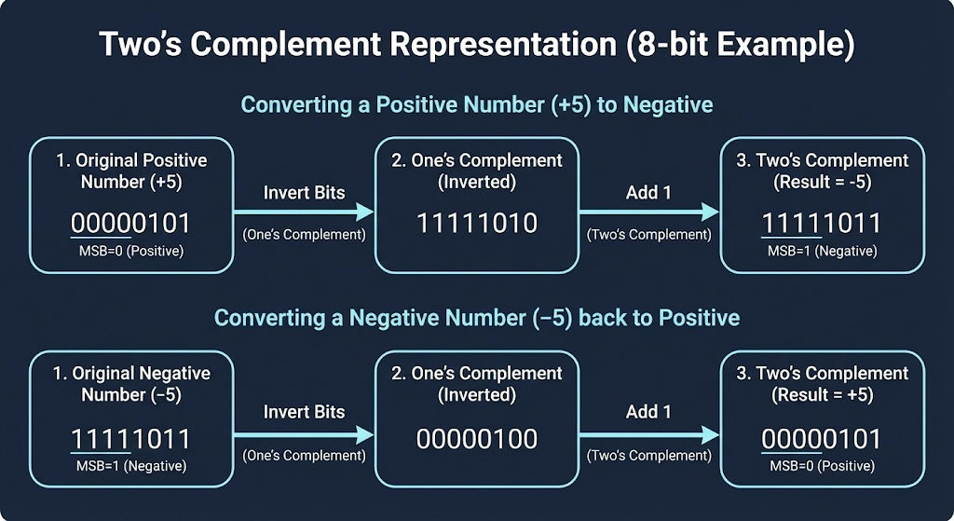
Binary Numbers & 2’s Complement
Binary Representation
Numbers expressed in base-2, using only 0s and 1s. Positive numbers are straightforward; negative numbers use 2’s complement.
2’s Complement Steps
Invert all bits (1s become 0s, 0s become 1s).
Add 1 to the least significant bit.
Why 2’s Complement?
Simplifies subtraction into addition, making arithmetic operations consistent for signed numbers in Booth’s Algorithm.
+5: 0101
-3: 1101 (2’s complement of 0011)

Slide 6
Advantages of Booth’s Algorithm
Efficiently multiplies signed binary numbers
Reduces the number of addition and subtraction operations
Handles positive and negative numbers without extra
logic
Improves speed and performance of multiplication
Requires less hardware complexity compared to traditional methods
Suitable for processor and ALU implementation

Slide 7
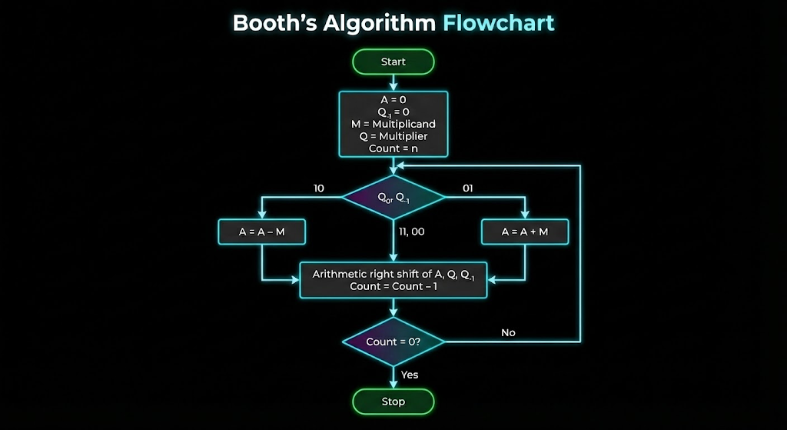


Booth’s Algorithm Flowchart

Slide 8
4-Bit Multiplication Example
Let's multiply 2 (0010) by -3 (1101) using Booth's Algorithm.
Initial
Q₀Q₋₁
Description
A(0000)
Q(1101)
Q₋₁
1
10
A = A - M (0010)
1110
1101
0
Arithmetic Right Shift
1111
0110
1
2
01
A = A + M (0010)
0001
0110
1
Arithmetic Right Shift
0000
1011
0
3
10
A = A - M (0010)
1110
1011
0
Arithmetic Right Shift
1111
0101
1
4
11
No Operation
1111
0101
1
Arithmetic Right Shift
1111
1010
1
Final Result: 11111010 (which is -6 in 8-bit 2's complement).

Slide 9
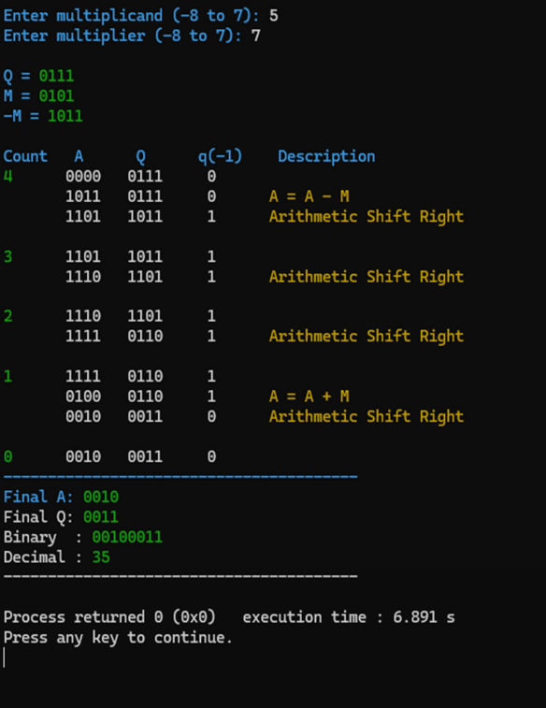
C++ Program Output

Slide 10



Conclusion
Booth’s Algorithm is an efficient technique for signed binary multiplication. In this project, a 4-bit
word multiplier was implemented using Booth’s Algorithm to correctly handle both positive and
negative numbers in 2’s complement form.
The algorithm reduces unnecessary arithmetic operations compared to traditional methods, making it suitable for use in computer processors and ALU design.
Thank you for your attention.

